Slide 1
Peeing and menstruation during fieldwork

Slide 2
Tips for hiking when…
'nature calls’
If you are new to 'going' in the bush, take your time,
and
be patient with others too ☺
What to bring
Small hand trowel – to dig holes
Small roll of toilet paper
Hand sanitiser
Lots of ziplock bags – for disposal
Intimate cleansing wipes (neutral pH)
Pads and tampons
Menstrual cup, if you use it
Bottle of water – to rinse menstrual cup and/or hands
Lightweight towel or sarong – for privacy in open areas without much cover
Period underwear is an excellent option for shorter trips, but may be difficult on long trips with limited washing facilities.
“Our participants all reported experiencing menstruation at some point during their field training. They all expressed issues of discomfort, pain, and anxiety which affected their ability to work optimally”
- Pickering and Khosa 2023

Slide 3
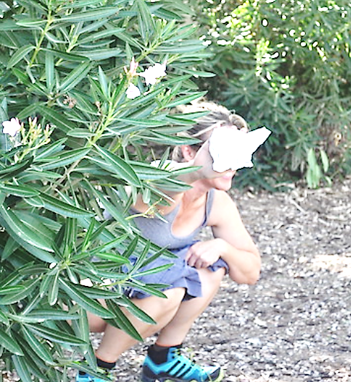

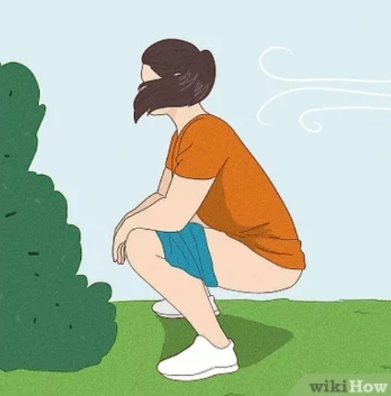
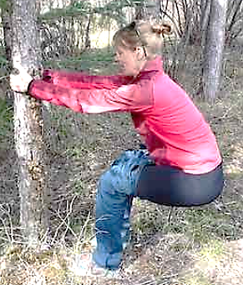
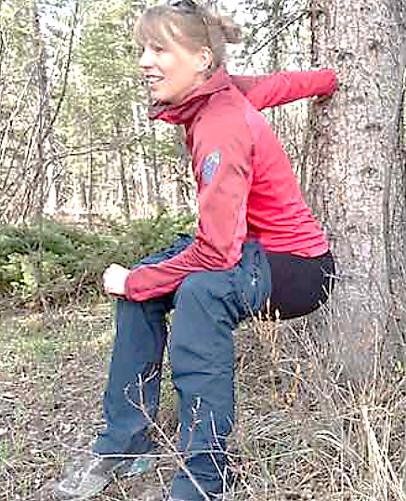
Bush toilet tips
On your period
Walk at least 50m away from the group, not near any tracks or streams
Buddy system: bring a friend to watch your back
Find a private spot behind shrubs or bushes – but watch out for snakes
If there is not enough bush cover, you could wrap a towel, sarong or jacket around your waist – be careful not to wet your clothes!
Lower your trousers or shorts halfway down your thighs, but not below your knees or they may get wet. If wearing long pants, roll up the cuffs first.
Squat down as low as you comfortably can, and do your business below your garments so they stay clean.
Squat facing downslope so it drips away and you don't wet your boots
If you can't squat for long – try holding onto a shrub in front of you for support, or you can rest your back against a tree or boulder to prop yourself up
Bury your toilet paper and business at least 20cm deep – bring a small hand trowel
What product is best? Use what you're comfortable with, but avoid reusable period underwear if you don't have washing facilities
Using Menstrual cups? – dig a hole to empty the contents into. Sanitise hands first. Bring a water bottle to rinse the cup before you reinsert.
Using tampons and/or pads? - bring LOTS of ziplock bags. You might want to doublebag if you're squeamish or afraid of leaks in your backpack. Then you can dispose in the bin back at camp.
Instead of ziplock bags, you might prefer scented black sanitary bags, or nappy disposal bags with handles to securely tie the bags up. Find them in the supermarket.
Not sure if you'll be on your period? Bring tampons and pads anyway! Someone else might have an emergency and will really appreciate your spare products ☺
Look for intimate cleansing wipes in the supermarket or chemist (make sure they are pH balanced) – these are gentle on your skin and could help you feel a lot fresher after a lot hot day of hiking on your period!
You might get a rash hiking with bulky pads for long hours. Stop and change if you feel uncomfortable.
If you have trouble squatting

Slide 4
Peeing standing up
Behind a tree or bush: This is one of the simplest methods. Find a secluded spot behind a tree or bush, and urinate. However, be cautious of potential hazards like snakes, spiders, or insects that might be hiding in the vegetation.
Pee downhill, pee away from the wind

Slide 5
Going to the toilet in the field #2s
Try to go in the morning before heading out, but sometimes you just need to go

Slide 6
1. Choose the Right Location:
  - Pick a spot at least 60 meters away from water sources like creeks, rivers, or dams to prevent contamination.
  - Avoid delicate ecosystems, well-travelled tracks, and campgrounds.
2. Gather Supplies:
  - Trowel
  - Unscented, biodegradable toilet paper or moist towelettes.
  - Sealable plastic bag for packing used toilet paper (Pack it in, pack it out!).
3. Dig a Cat Hole:
  - Find an area with loose, soft soil.
  - Watch out for snakes under trees/behind logs.
  - Use your trowel to dig a hole about 15-20 cm deep and 10-15 cm wide. This hole will serve as your makeshift toilet.
  - If you don’t have a trowel, do your best using a sturdy stick, the heel of your boot, and/or unearthing a mid-size stone.
4. Do Your Business:
- Squat over the cat hole and do your business.
5. Use toilet paper sparingly and pack used paper in your plastic bag to take away with you.
- If you don’t have a bag, bury paper deeply.
6. Cover and Clean Up:
  - Use the trowel to fill the cat hole with soil, completely covering your waste.
  - Compact the soil on top to make it level with the surrounding ground.
  - Wash your hands with soap and water if available or use hand sanitiser.
7. Leave No Trace:
  - Ensure there are no visible signs of your visit when you leave
  - Educate others in your group about proper bush toilet practices.

